Slide 1
Electronic devices

Slide 2

Electronic Devices

Slide 3

Students are addicted to Facebook, Instagram, Twitter and other websites from a very early age

Slide 4
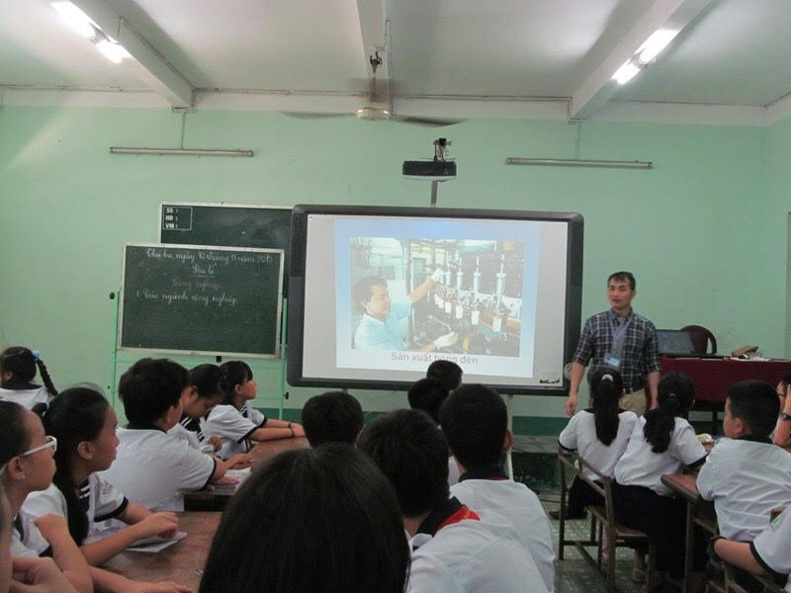
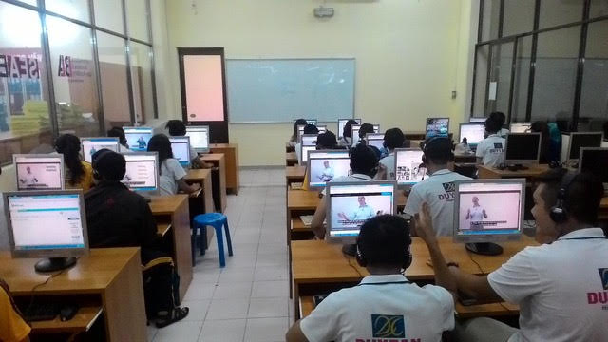
Making learning enjoyable

Slide 5

Set up a private Facebook group for your class and inspire constructive conversations

Slide 6
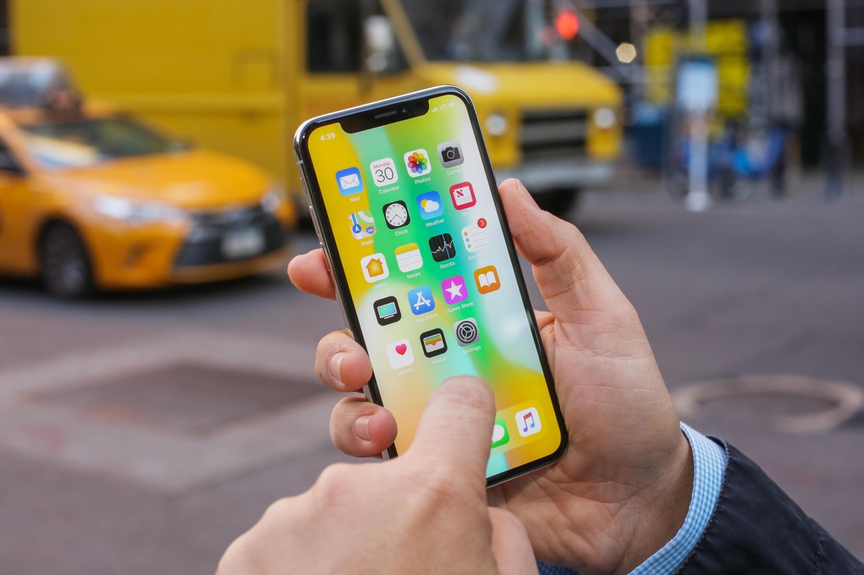
Without the wonders of the internet, people wouldn’t be able to get access to any type of information at the very moment they think of it

Slide 7


Since the introduction of computers, tablets, and mobile phones, there has been a great scope of education applications that allow learners to learn various concepts in a playful manner

Slide 8
Thanks for watching!

